Slide 1
Introduction to Bayesian Statistics

Slide 2
Conditional Probability
First, let’s review conditional probability

Slide 3
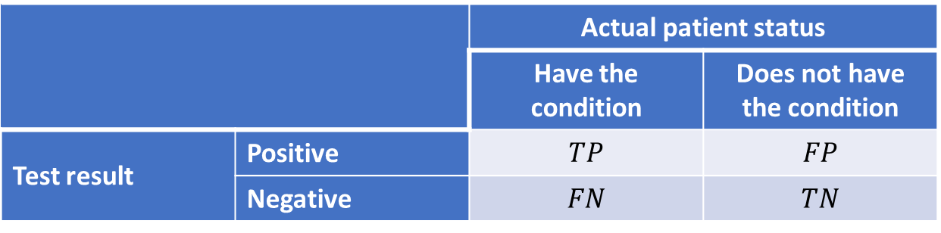
Conditional Probability
 |  | Actual patient status
 |  | Have the condition | Does not have the condition
Test result | Positive | $$TP$$ | $$FP$$
 | Negative | $$FN$$ | $$TN$$
TP = True positives
TN = True negatives
FP = False positives
FN = False negatives

Slide 4
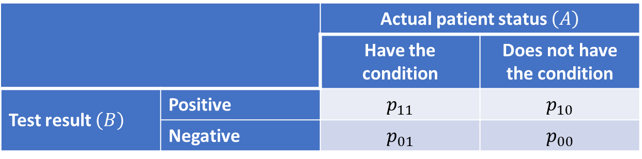
Bayes theorem
Example: positive predictive value (PPV)
 |  | Actual patient status $\left(A\right)$
 |  | Have the condition | Does not have the condition
Test result $\left(B\right)$ | Positive | $$p_{11}$$ | $$p_{10}$$
 | Negative | $$p_{01}$$ | $$p_{00}$$

Slide 5
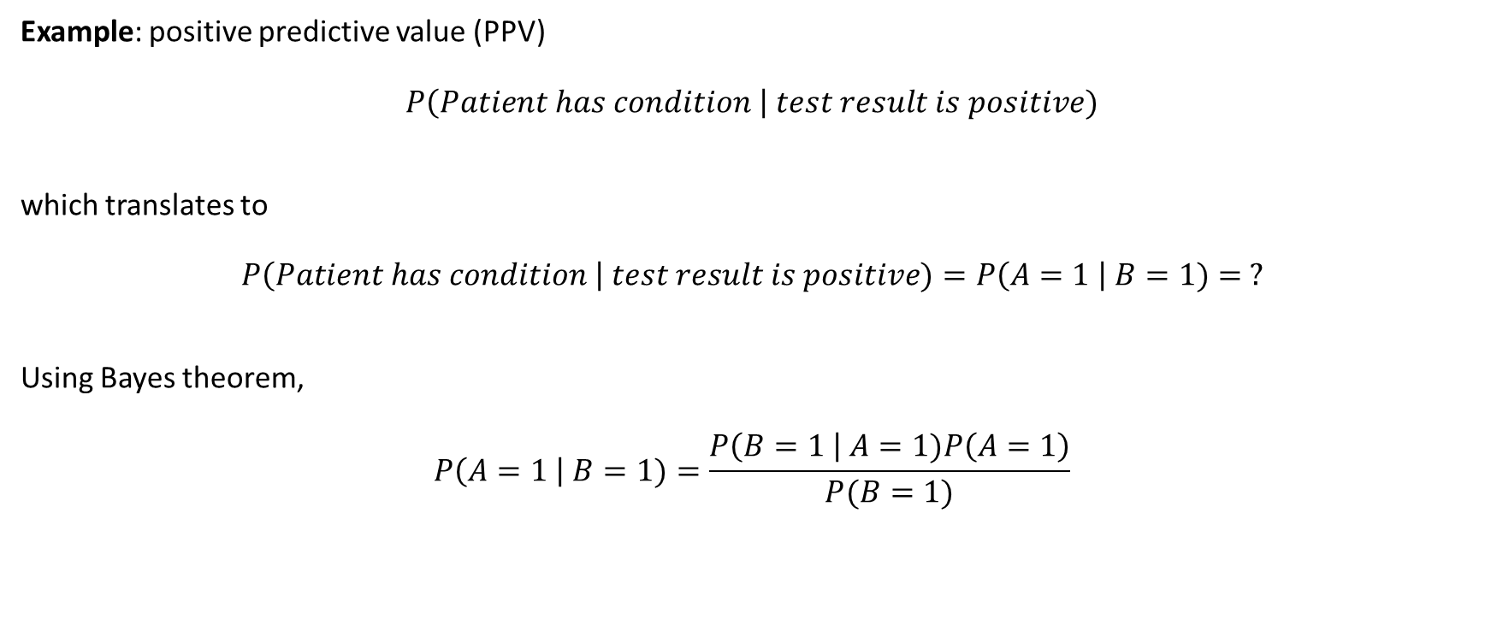
Bayes theorem
Example: positive predictive value (PPV)
$$P\left(Patient has condition \right| test result is positive)$$
which translates to
$$P\left(Patient has condition \right| test result is positive)=P\left(A=1 \right| B=1)= ?$$
Using Bayes theorem,
$$P\left(A=1 \right| B=1)=\frac{P\left(B=1 \right| A=1)P\left(A=1\right)}{P(B=1)}$$

Slide 6
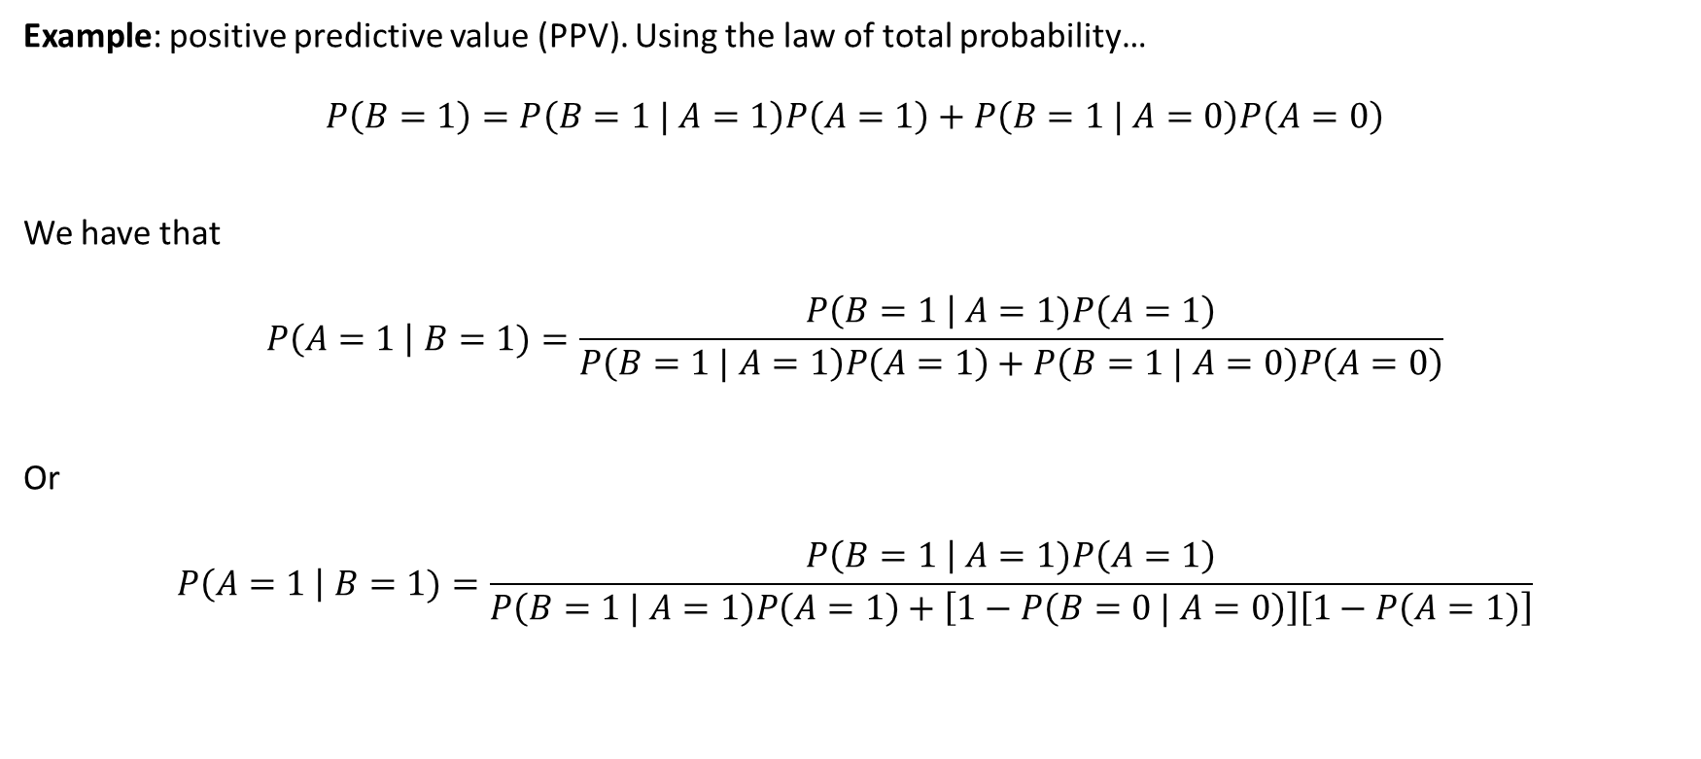
Bayes theorem
Example: positive predictive value (PPV). Using the law of total probability…
$$P\left(B=1\right)=P\left(B=1 | A=1\right)P\left(A=1\right)+P\left(B=1 | A=0\right)P\left(A=0\right)$$
We have that
$$P\left(A=1 \right| B=1)=\frac{P\left(B=1 \right| A=1)P\left(A=1\right)}{P\left(B=1 | A=1\right)P\left(A=1\right)+P\left(B=1 | A=0\right)P\left(A=0\right)}$$
Or
$$P\left(A=1 \right| B=1)=\frac{P\left(B=1 \right| A=1)P\left(A=1\right)}{P\left(B=1 | A=1\right)P\left(A=1\right)+\left[1−P\left(B=0 | A=0\right)\right]\left[1−P\left(A=1\right)\right]}$$

Slide 7
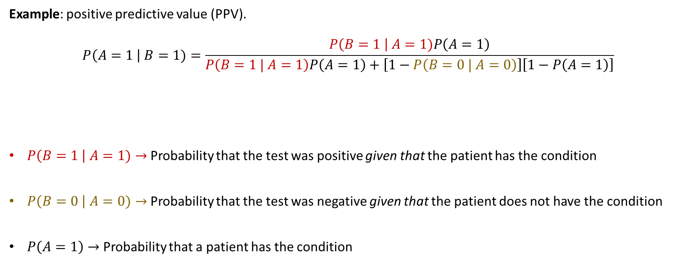
Bayes theorem
Example: positive predictive value (PPV).
$$P\left(A=1 \right| B=1)=\frac{P\left(B=1 \right| A=1)P\left(A=1\right)}{P\left(B=1 | A=1\right)P\left(A=1\right)+\left[1−P\left(B=0 | A=0\right)\right]\left[1−P\left(A=1\right)\right]}$$
$P\left(B=1 \right| A=1)→$ Probability that the test was positive given that the patient has the condition
$P\left(B=0 \right| A=0)→$ Probability that the test was negative given that the patient does not have the condition
$P\left(A=1\right)→$ Probability that a patient has the condition

Slide 8
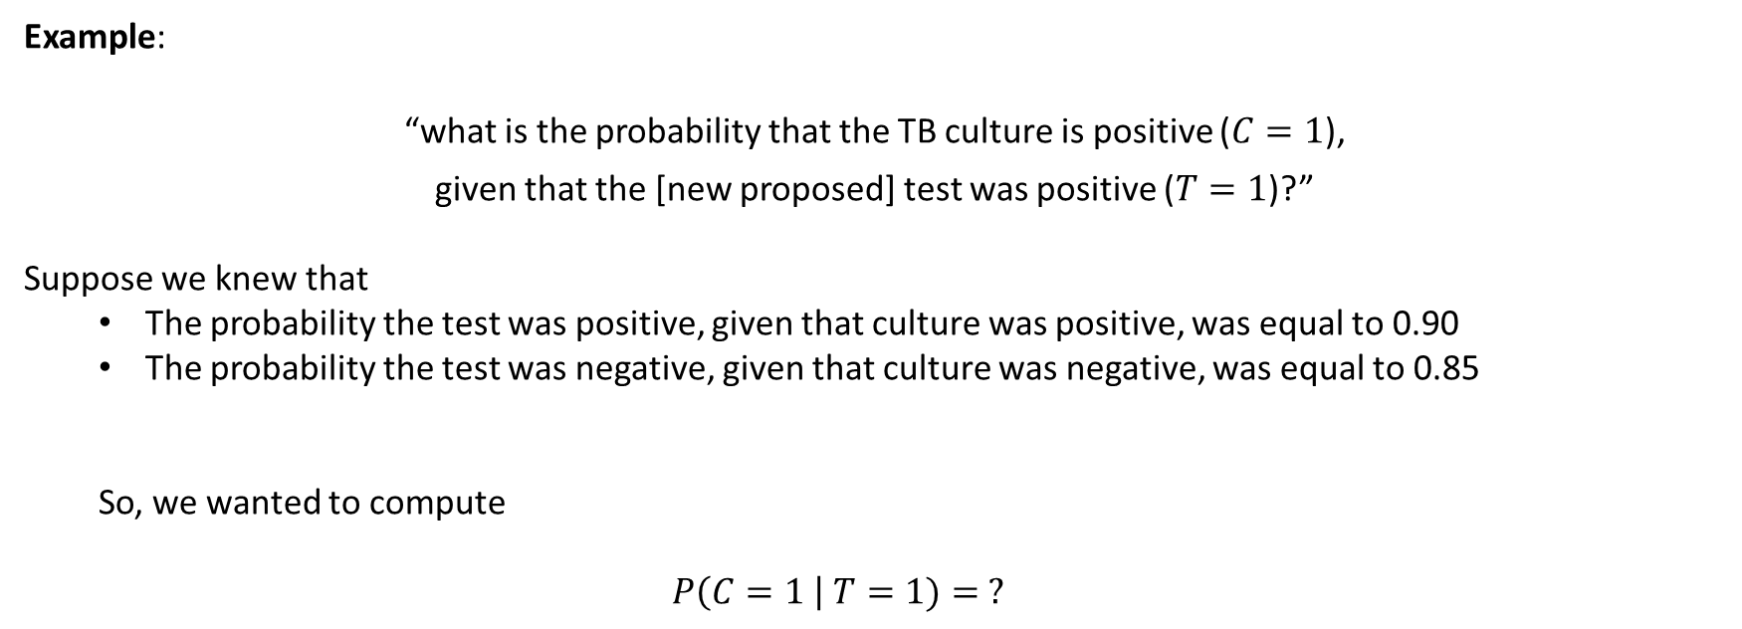
Bayes theorem
Example:
“what is the probability that the TB culture is positive ($C=1$),
given that the [new proposed] test was positive ($T=1$)?”
Suppose we knew that
  The probability the test was positive, given that culture was positive, was equal to 0.90
  The probability the test was negative, given that culture was negative, was equal to 0.85
  So, we wanted to compute
  $$P\left(C=1 \right| T=1)= ?$$

Slide 9
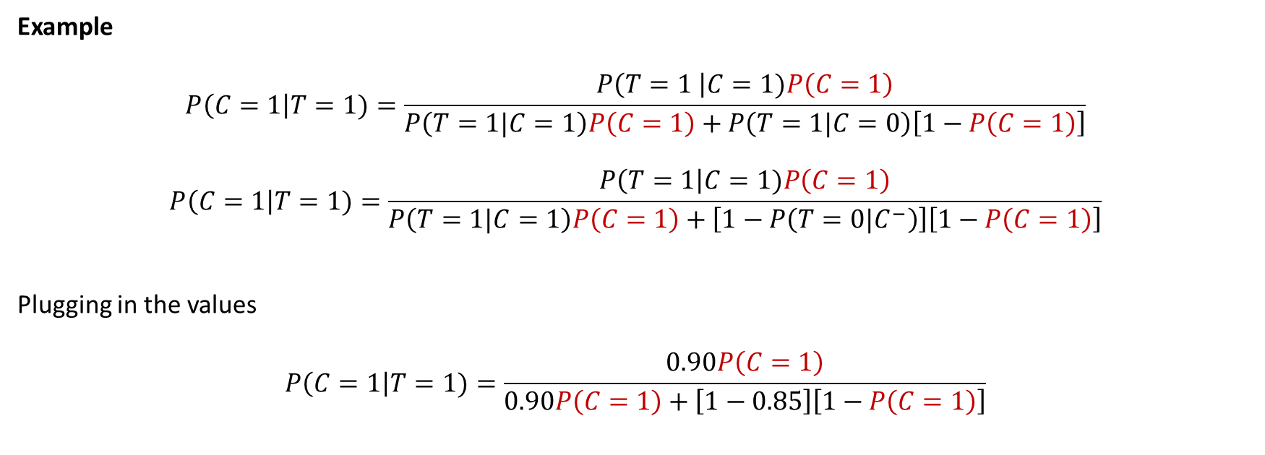
Bayes theorem
Example
$$P\left(C=1\right|T=1)=\frac{P\left(T=1 \right|C=1)P\left(C=1\right)}{P\left(T=1|C=1\right)P\left(C=1\right)+P\left(T=1|C=0\right)\left[1−P\left(C=1\right)\right]}$$
$$P\left(C=1\right|T=1)=\frac{P\left(T=1\right|C=1)P\left(C=1\right)}{P\left(T=1|C=1\right)P\left(C=1\right)+\left[1−P\left(T=0|C^{−}\right)\right]\left[1−P\left(C=1\right)\right]}$$
Plugging in the values
$$P\left(C=1\right|T=1)=\frac{0.90P\left(C=1\right)}{0.90P\left(C=1\right)+\left[1−0.85\right]\left[1−P\left(C=1\right)\right]}$$

Slide 10
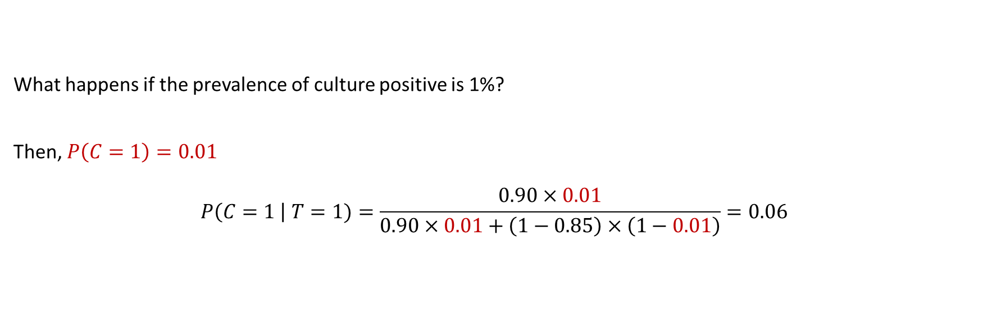
Bayes theorem
What happens if the prevalence of culture positive is 1%?
Then, $P\left(C=1\right)=0.01$
$$P\left(C=1 \right| T=1)=\frac{0.90×0.01}{0.90×0.01+\left(1−0.85\right)×\left(1−0.01\right)}=0.06$$

Slide 11
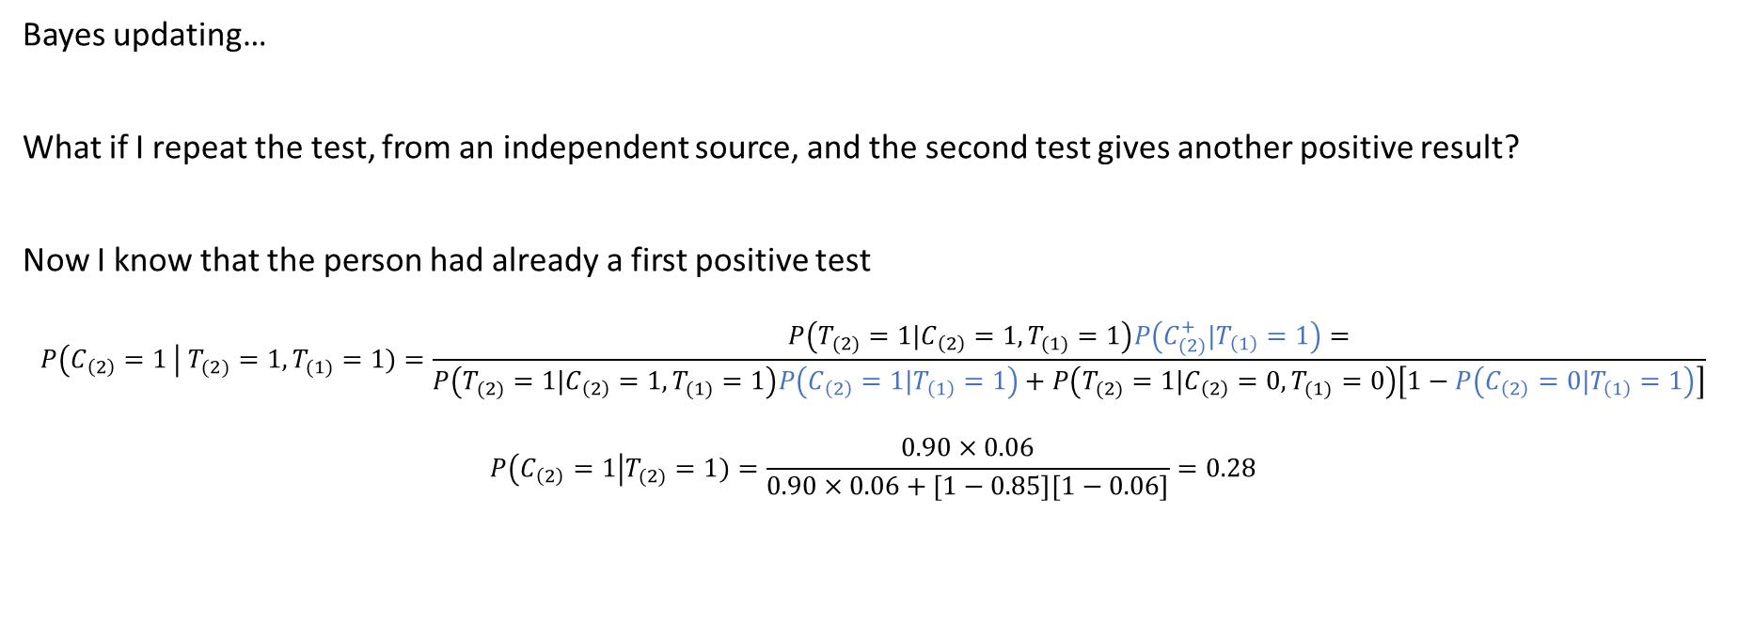
Bayes theorem
Bayes updating…
What if I repeat the test, from an independent source, and the second test gives another positive result?
Now I know that the person had already a first positive test
$$P\left(C_{\left(2\right)}=1 \right| T_{(2)}=1,T_{(1)}=1)=\frac{P\left(T_{(2)}=1|C_{\left(2\right)}=1,T_{(1)}=1\right)P\left(C_{(2)}^{+}|T_{\left(1\right)}=1\right)=}{P\left(T_{(2)}=1|C_{\left(2\right)}=1,T_{(1)}=1\right)P\left(C_{\left(2\right)}=1|T_{\left(1\right)}=1\right)+P\left(T_{(2)}=1|C_{\left(2\right)}=0,T_{(1)}=0\right)\left[1−P\left(C_{\left(2\right)}=0|T_{\left(1\right)}=1\right)\right]}$$
$$P\left(C_{\left(2\right)}=1\right|T_{(2)}=1)=\frac{0.90×0.06}{0.90×0.06+\left[1−0.85\right]\left[1−0.06\right]}=0.28$$

Slide 12
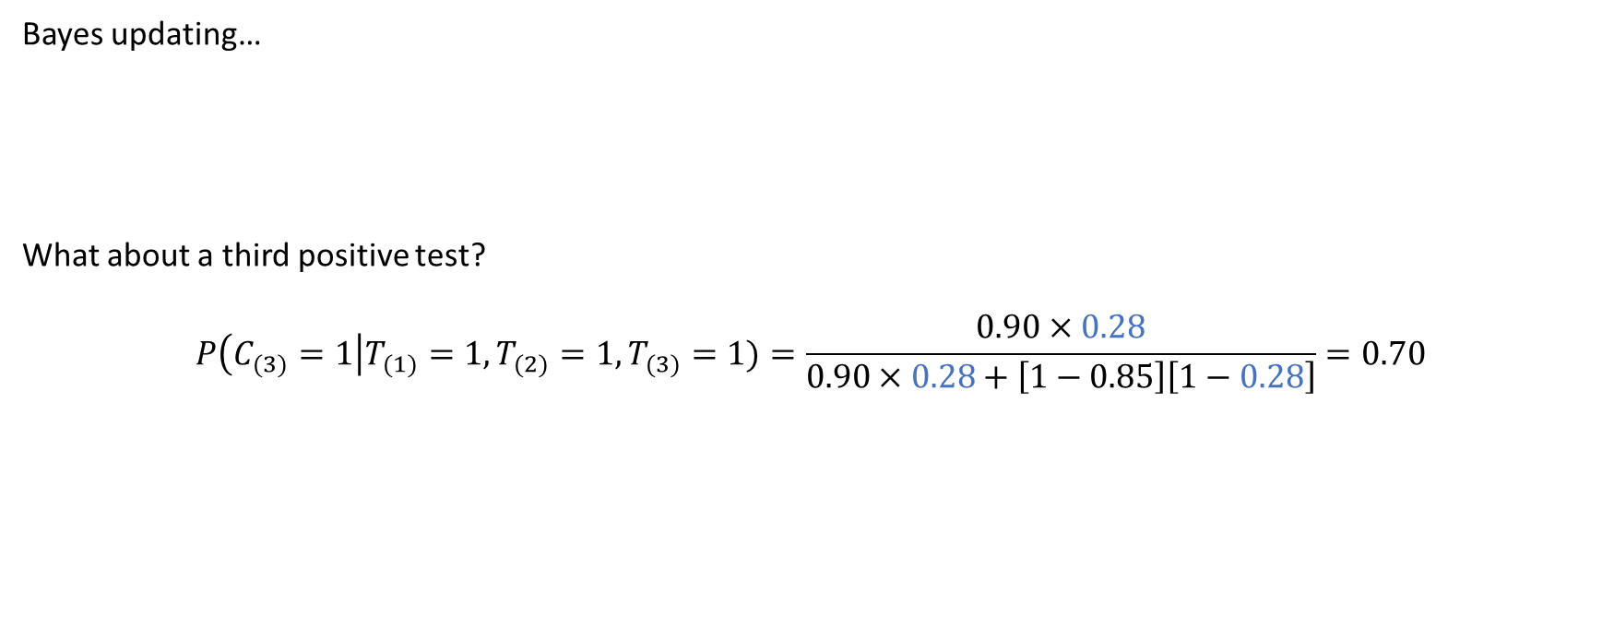
Bayes theorem
Bayes updating…
What about a third positive test?
$$P\left(C_{(3)}=1\right|T_{(1)}=1,T_{(2)}=1,T_{(3)}=1)=\frac{0.90×0.28}{0.90×0.28+\left[1−0.85\right]\left[1−0.28\right]}=0.70$$

Slide 13
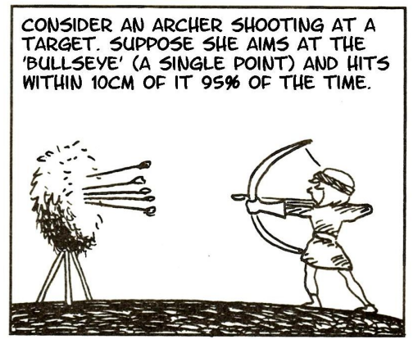
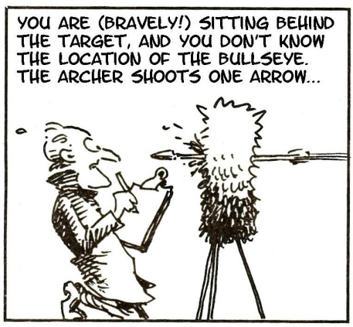
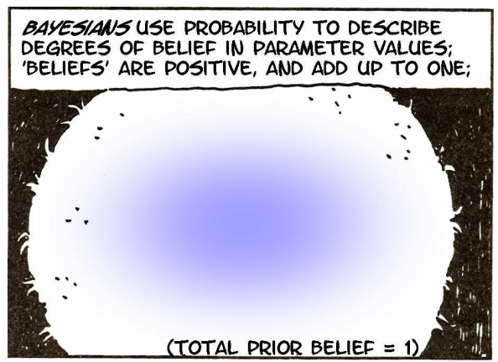
Bayesian inference
Adapted from Gonick & Smith, The Cartoon Guide to Statistics

Slide 14
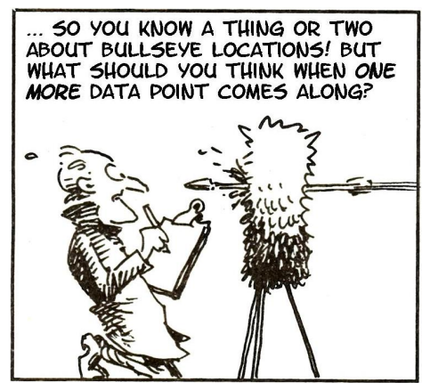
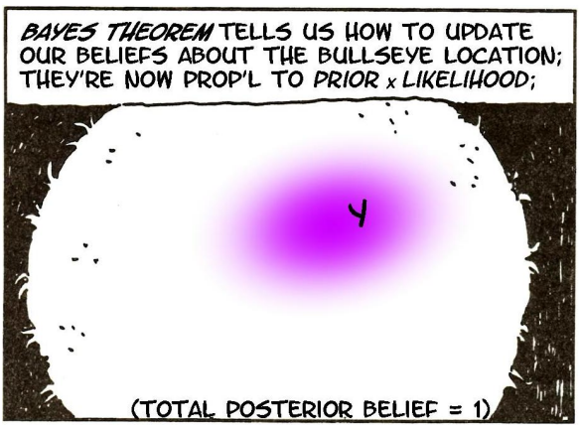
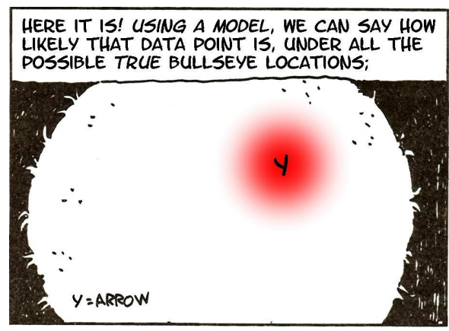
Bayesian inference

Slide 15
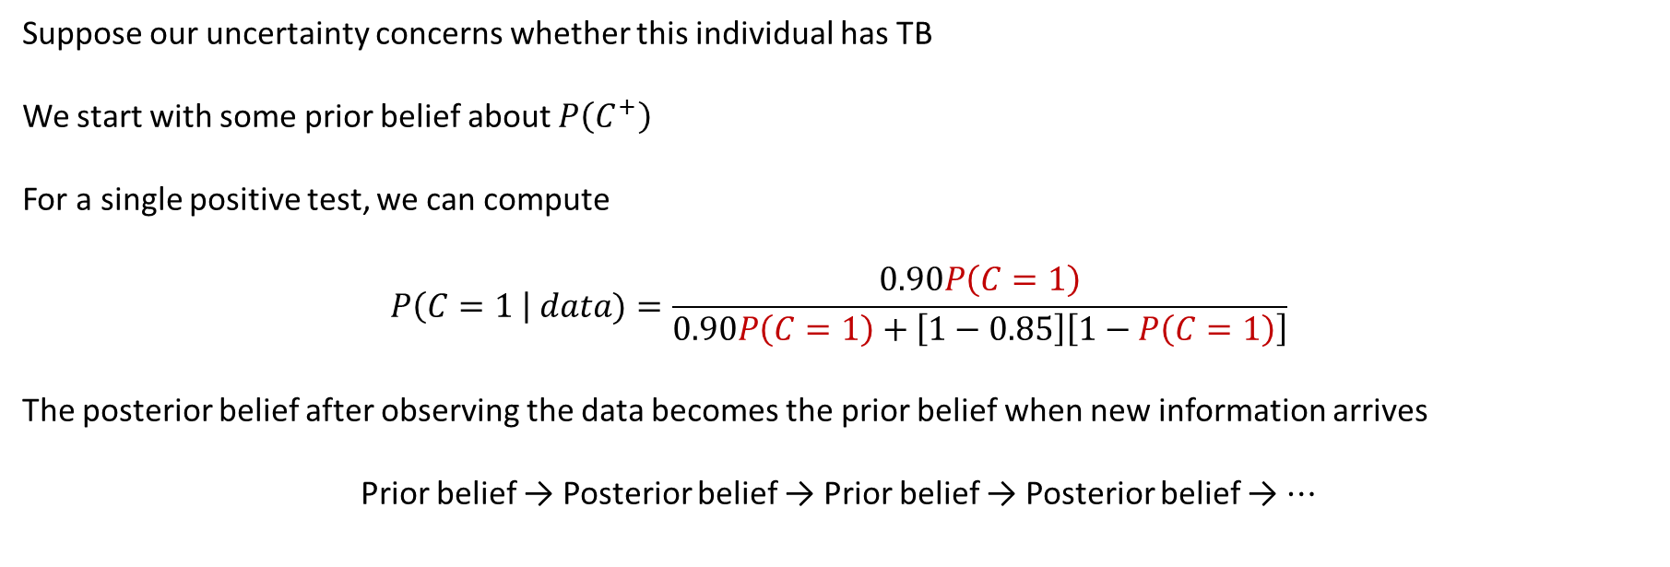
Bayesian update
Suppose our uncertainty concerns whether this individual has TB
We start with some prior belief about $P\left(C^{+}\right)$
For a single positive test, we can compute
$$P\left(C=1 \right| data)=\frac{0.90P\left(C=1\right)}{0.90P\left(C=1\right)+\left[1−0.85\right]\left[1−P\left(C=1\right)\right]}$$
The posterior belief after observing the data becomes the prior belief when new information arrives
Prior belief → Posterior belief → Prior belief → Posterior belief → ⋯

Slide 16
Bayesian inference
What is Bayesian statistics?
At this point, it is just a way to compute probabilities, which later can be used for inference
How different is it from frequentist statistics?

Slide 17
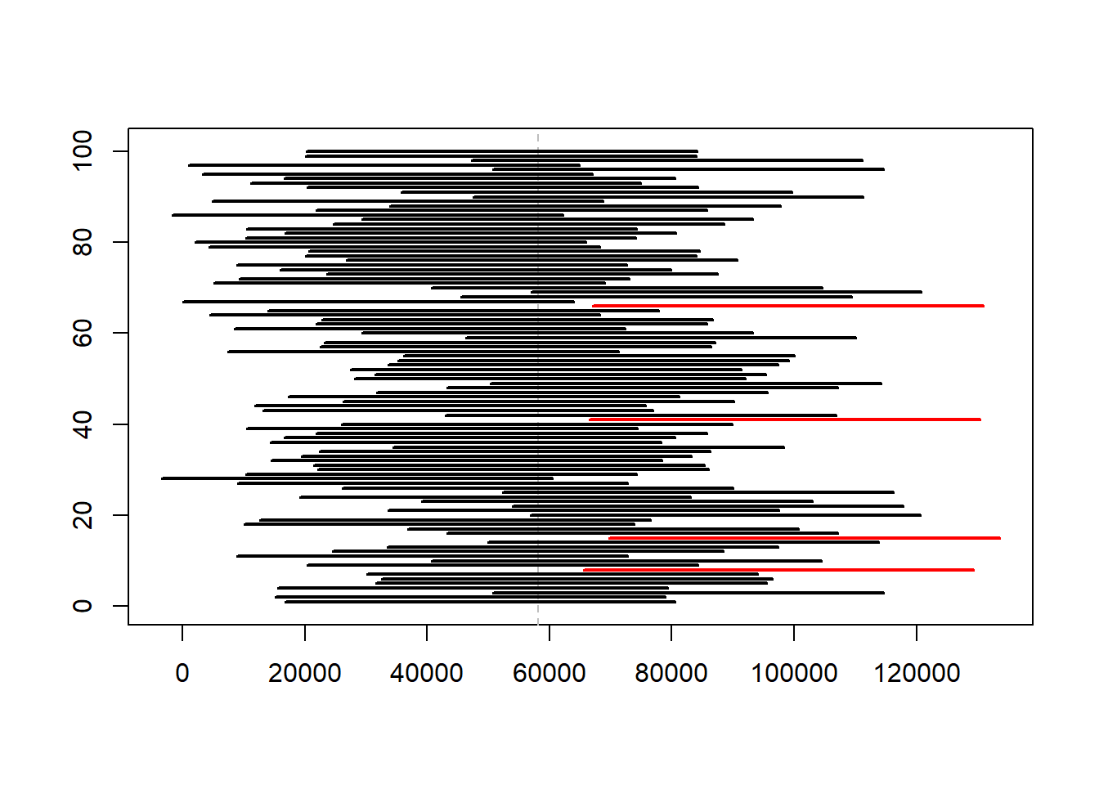
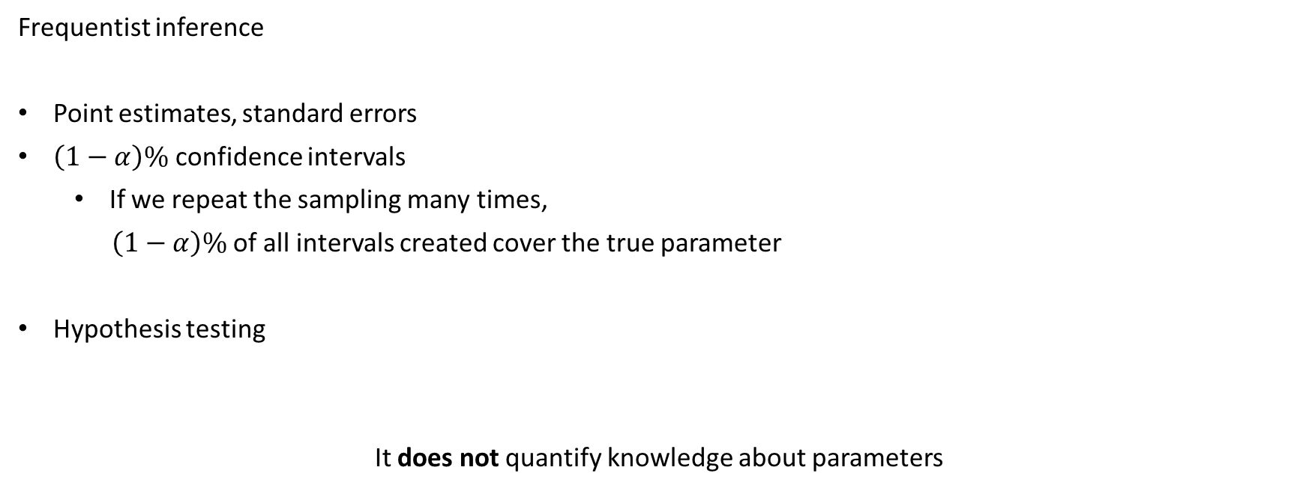
Frequentist statistics
Frequentist inference
Point estimates, standard errors
$\left(1−α\right)\%$ confidence intervals
  If we repeat the sampling many times,
  $\left(1−α\right)\%$of all intervals created cover the true parameter
Hypothesis testing
It does not quantify knowledge about parameters

Slide 18
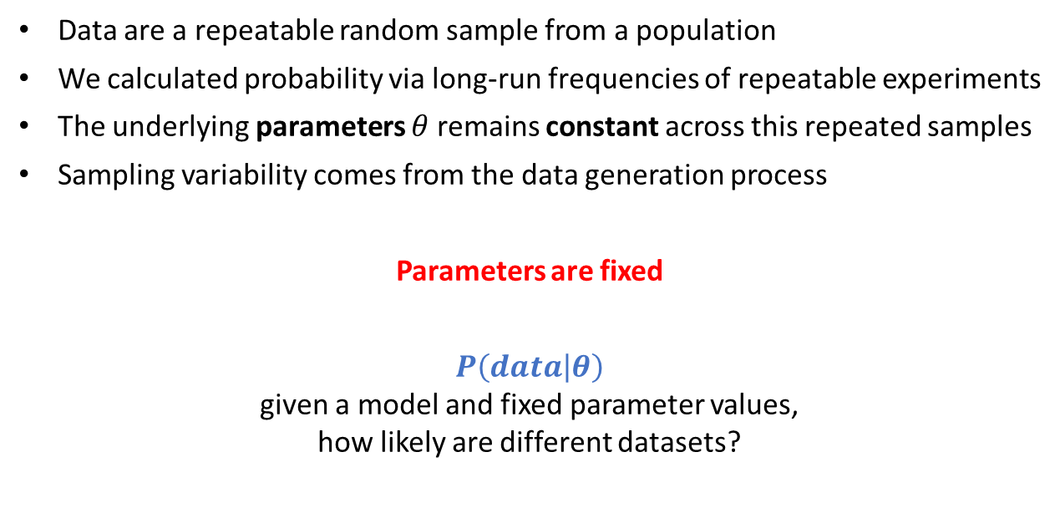
Frequentist statistics
Data are a repeatable random sample from a population
We calculated probability via long-run frequencies of repeatable experiments
The underlying parameters $θ$ remains constant across this repeated samples
Sampling variability comes from the data generation process
Parameters are fixed
$$P\left(data | θ\right)$$
given a model and fixed parameter values,
how likely are different datasets?

Slide 19
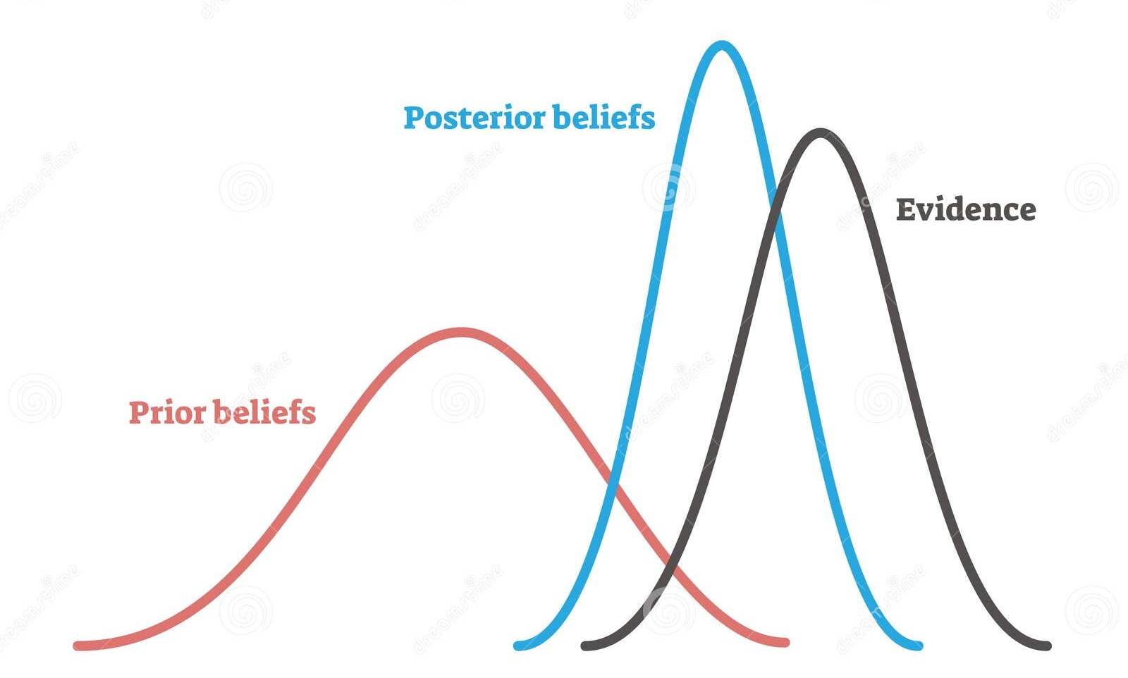
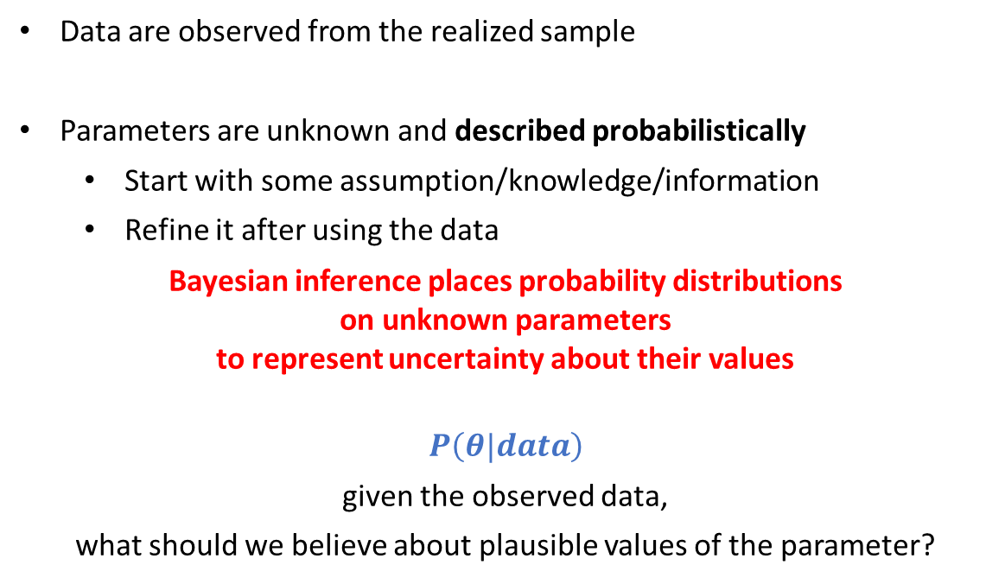
Bayesian inference
Density
Data are observed from the realized sample
Parameters are unknown and described probabilistically
  Start with some assumption/knowledge/information
  Refine it after using the data
Bayesian inference places probability distributions
on unknown parameters
to represent uncertainty about their values
$$P\left(θ|data\right)$$
given the observed data,
what should we believe about plausible values of the parameter?
Parameter

Slide 20
Bayesian inference
How different is Bayesian inference to frequentist inference?
Bayesian inference typically focuses on posterior distributions
rather than confidence intervals, p-values, or sampling distributions.
Bayesians represent uncertainty about unknown parameters using probability distributions
To a Bayesian, probability is the only way to describe uncertainty. Anything not known for certain, like the true values of parameters, must be described by a probability distribution.

Slide 21
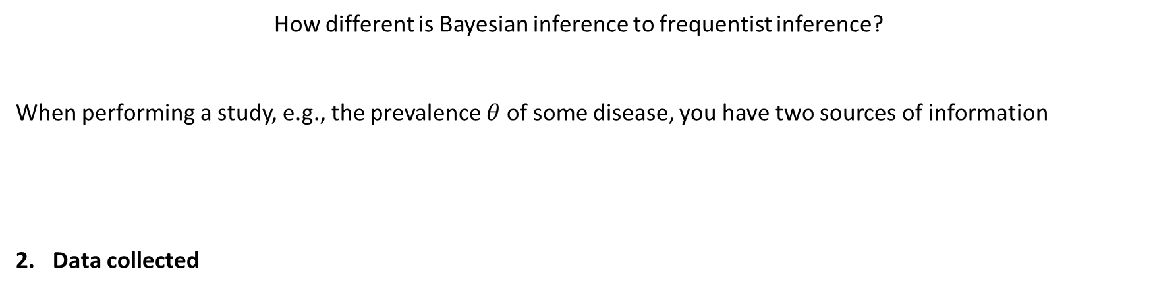
Bayesian inference
How different is Bayesian inference to frequentist inference?
When performing a study, e.g., the prevalence $θ$of some disease, you have two sources of information
Data collected

Slide 22
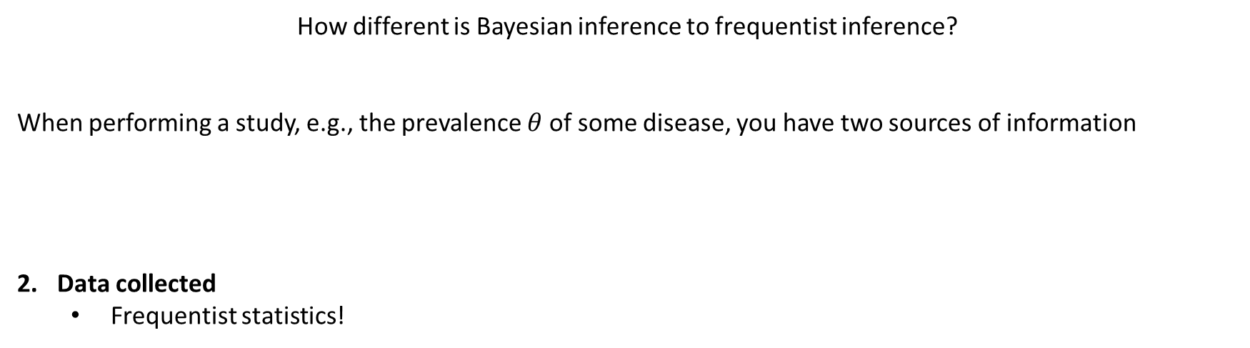
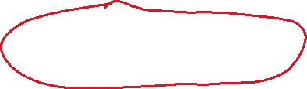
Bayesian inference
How different is Bayesian inference to frequentist inference?
When performing a study, e.g., the prevalence $θ$of some disease, you have two sources of information
Data collected
  Frequentist statistics!

Slide 23
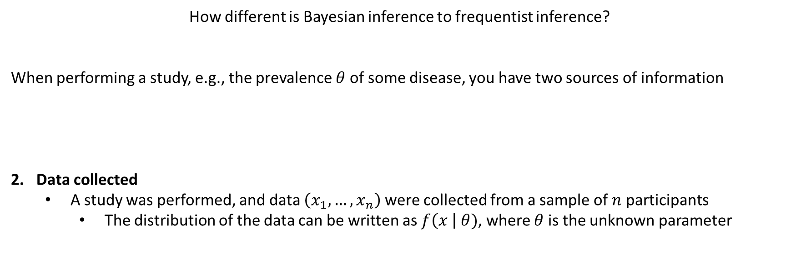
Bayesian inference
How different is Bayesian inference to frequentist inference?
When performing a study, e.g., the prevalence $θ$of some disease, you have two sources of information
Data collected
  A study was performed, and data $\left(x_{1},…, x_{n}\right)$were collected from a sample of $n$ participants
    The distribution of the data can be written as $f\left(x \right| θ)$, where $θ$ is the unknown parameter

Slide 24
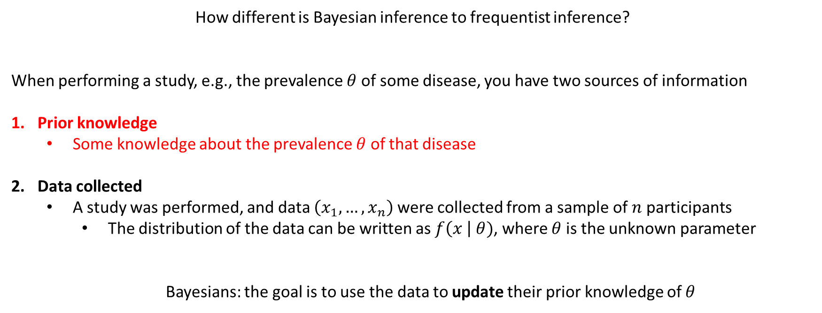
Bayesian inference
How different is Bayesian inference to frequentist inference?
When performing a study, e.g., the prevalence $θ$of some disease, you have two sources of information
Prior knowledge
  Some knowledge about the prevalence $θ$ of that disease
Data collected
  A study was performed, and data $\left(x_{1},…, x_{n}\right)$were collected from a sample of $n$ participants
    The distribution of the data can be written as $f\left(x \right| θ)$, where $θ$ is the unknown parameter
  Bayesians: the goal is to use the data to update their prior knowledge of $θ$

Slide 25
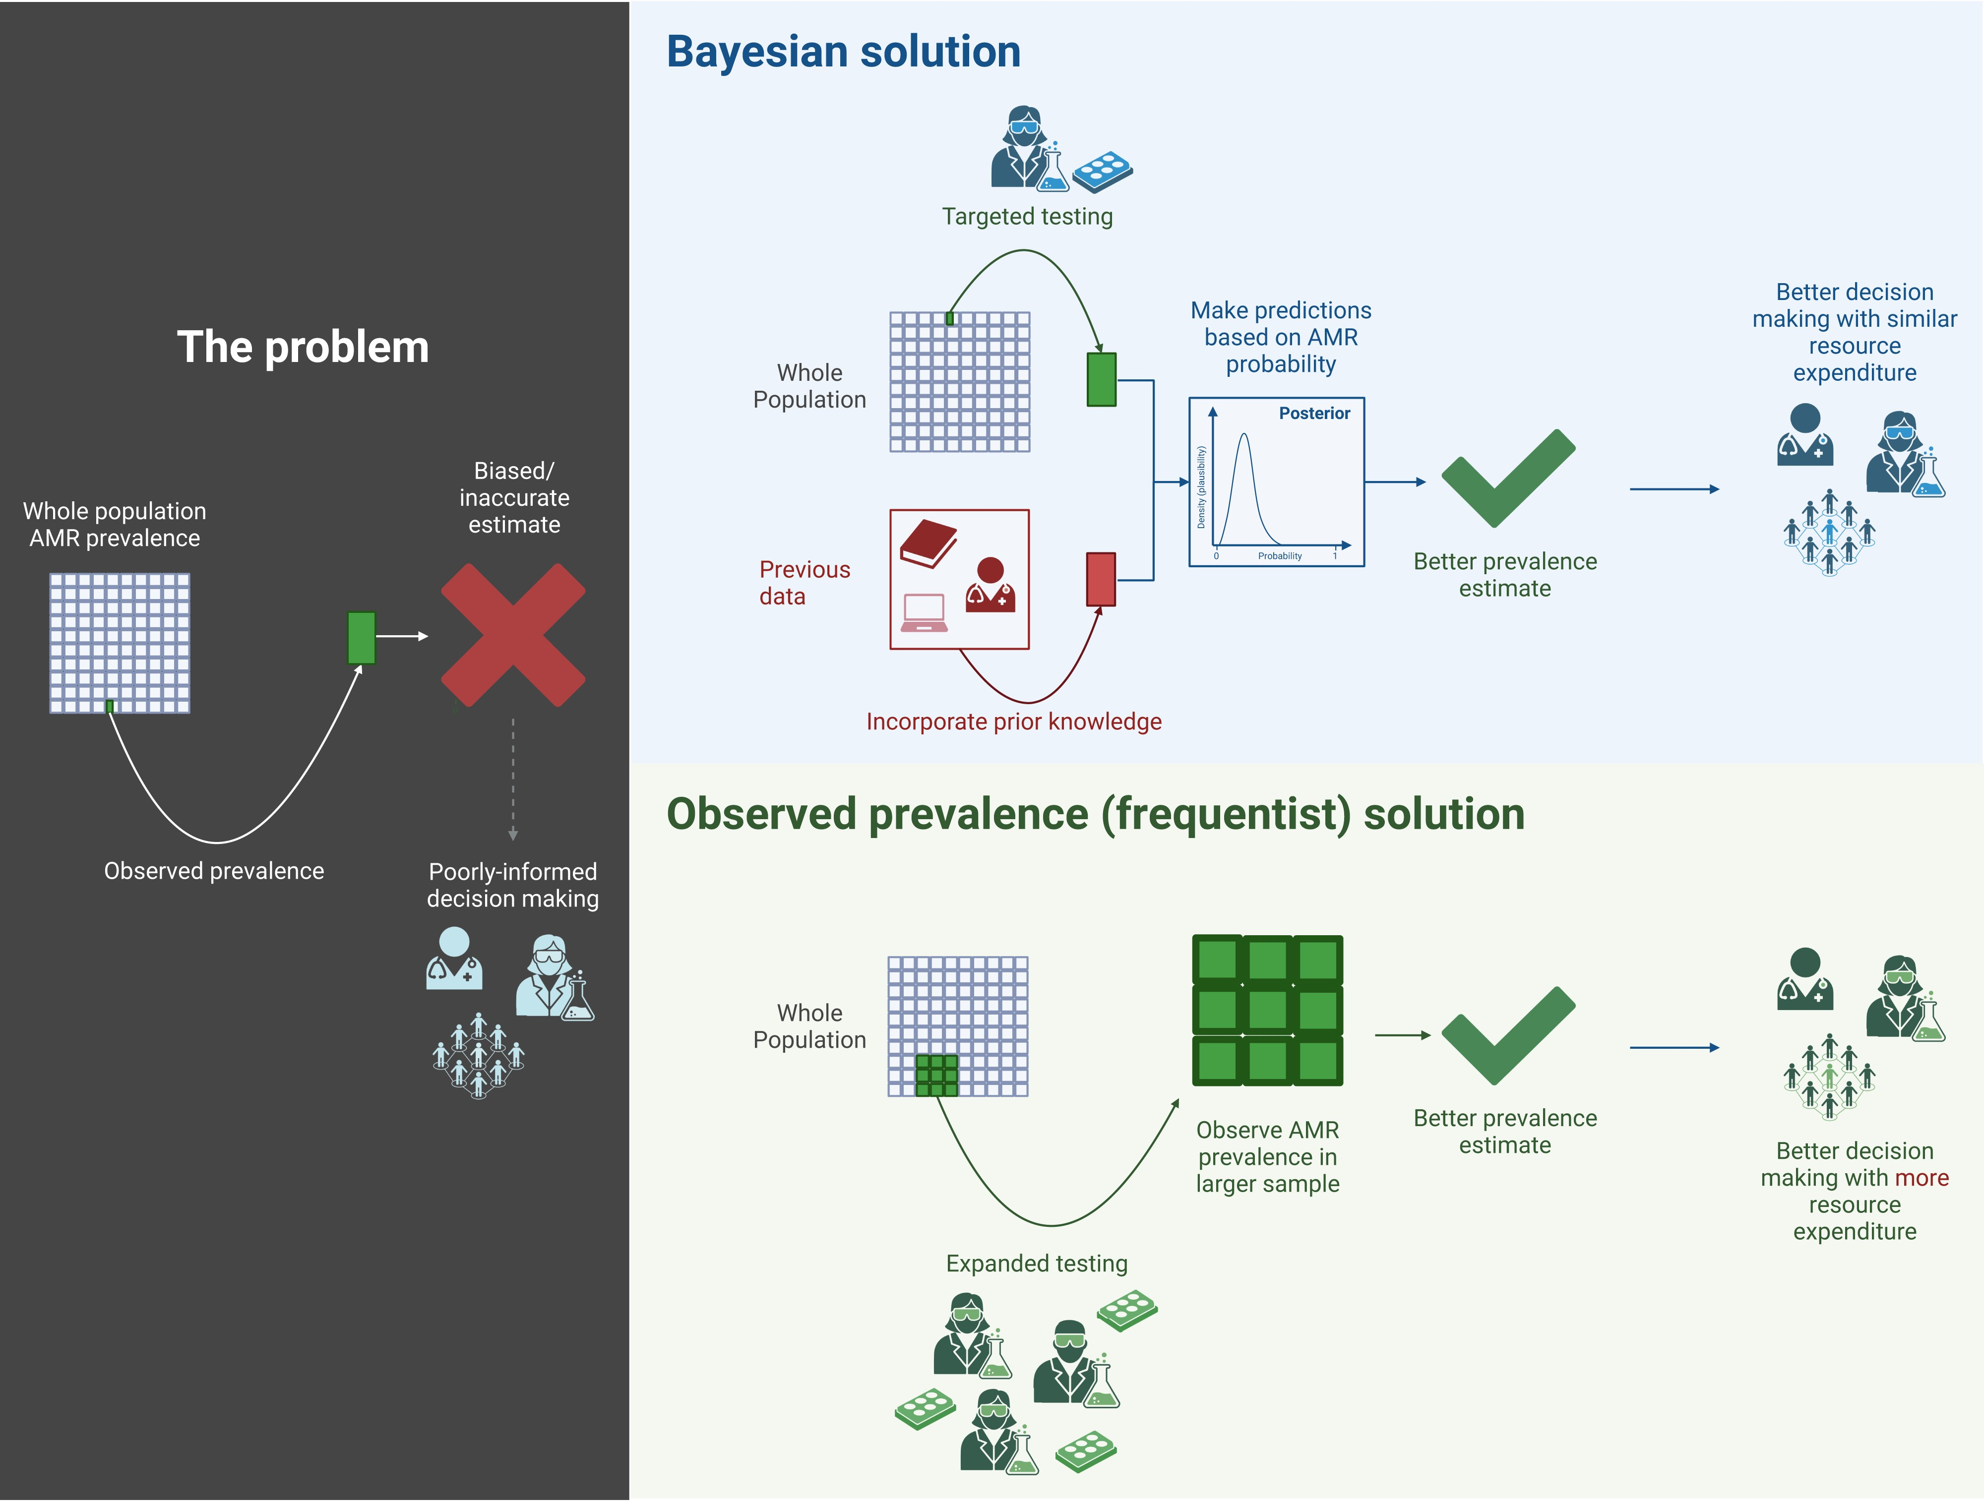
Bayesian inference
Ref: Howard, A., Green, P.L., Velluva, A., Gerada, A., Hughes, D.M., Brookfield, C., Hope, W. and Buchan, I., 2024. Bayesian estimation of the prevalence of antimicrobial resistance: a mathematical modelling study. Journal of Antimicrobial Chemotherapy, 79(9), pp.2317-2326.

Slide 26

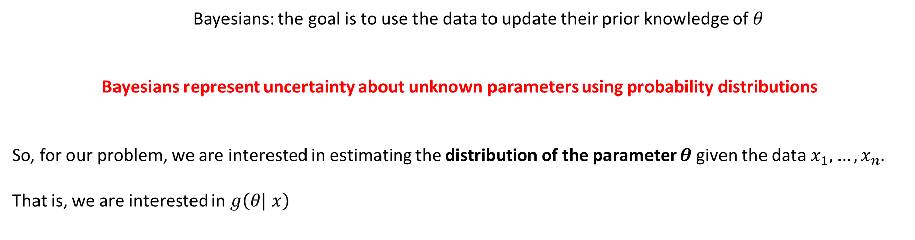
Bayesian inference
  Bayesians: the goal is to use the data to update their prior knowledge of $θ$
Bayesians represent uncertainty about unknown parameters using probability distributions
So, for our problem, we are interested in estimating the distribution of the parameter $θ$given the data $x_{1},…, x_{n}$.
That is, we are interested in $g\left(θ| x\right)$
Note: Distribution of the parameter $θ$: This makes no sense for a frequentist. They consider the parameter fixed!

Slide 27
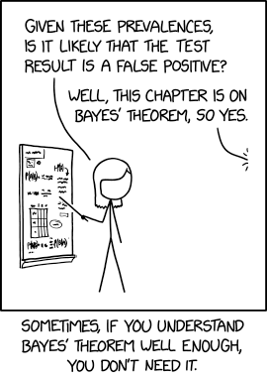
Bayesian inference
How can we compute $g\left(θ| x\right)$?

Slide 28
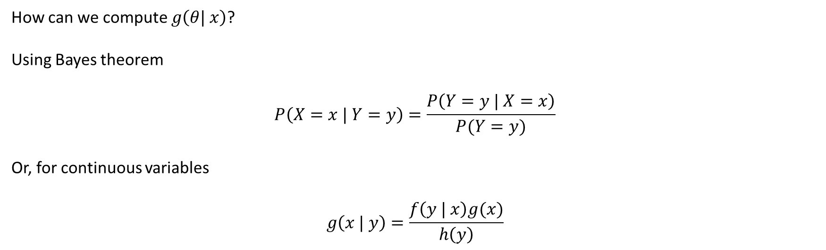
Bayesian inference
How can we compute $g\left(θ| x\right)$?
Using Bayes theorem
$$P\left(X=x | Y=y\right)=\frac{P\left(Y=y | X=x\right)}{P(Y=y)}$$
Or, for continuous variables
$$g\left(x | y\right)=\frac{f\left(y | x\right)g(x)}{h\left(y\right)}$$

Slide 29
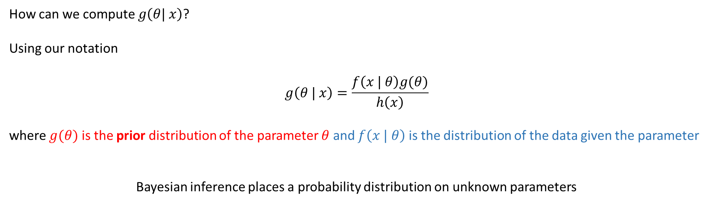
Bayesian inference
How can we compute $g\left(θ| x\right)$?
Using our notation
$$g\left(θ | x\right)=\frac{f\left(x | θ\right)g(θ)}{h\left(x\right)}$$
where $g(θ)$ is the prior distribution of the parameter $θ$ and $f\left(x | θ\right)$ is the distribution of the data given the parameter
Bayesian inference places a probability distribution on unknown parameters

Slide 30
Bayesian inference - summary
Suppose you are uncertain about something.
Then your uncertainty is described by a probability distribution called your prior distribution.
Next you obtain some data relevant to that thing.
The data changes your uncertainty, which is then described by a new probability distribution called your posterior distribution
The posterior distribution reflects the information both in the prior distribution and the data
Most of Bayesian inference is about how to go from prior to posterior.

Slide 31
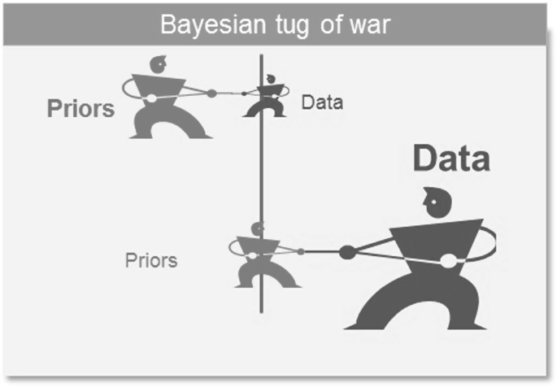
Bayesian inference - summary
Density
Parameter

Slide 32
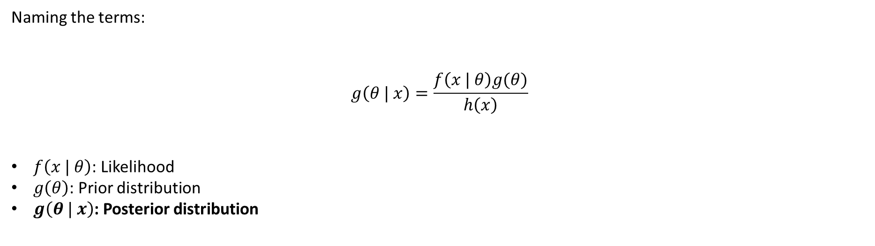
Bayesian inference
Naming the terms:
$$g\left(θ | x\right)=\frac{f\left(x | θ\right)g(θ)}{h\left(x\right)}$$
$f\left(x | θ\right)$: Likelihood
$g\left(θ\right)$: Prior distribution
$g\left(θ | x\right)$: Posterior distribution

Slide 33
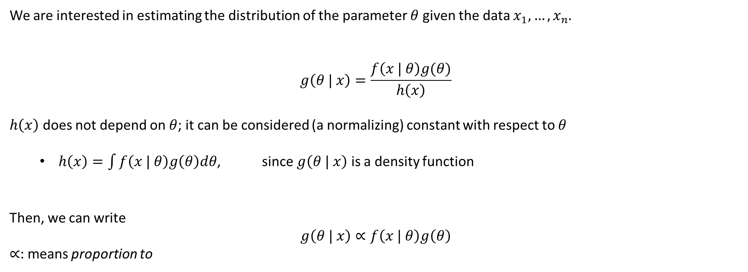
Bayesian inference
We are interested in estimating the distribution of the parameter $θ$given the data $x_{1},…, x_{n}$.
$$g\left(θ | x\right)=\frac{f\left(x | θ\right)g(θ)}{h\left(x\right)}$$
$h\left(x\right)$ does not depend on $θ$; it can be considered (a normalizing) constant with respect to $θ$
  $h\left(x\right)=\int{f\left(x | θ\right)g\left(θ\right)dθ}$, since $g\left(θ | x\right)$ is a density function
Then, we can write
$$g\left(θ | x\right)∝f\left(x | θ\right)g\left(θ\right)$$
$∝:$ means proportion to

Slide 34
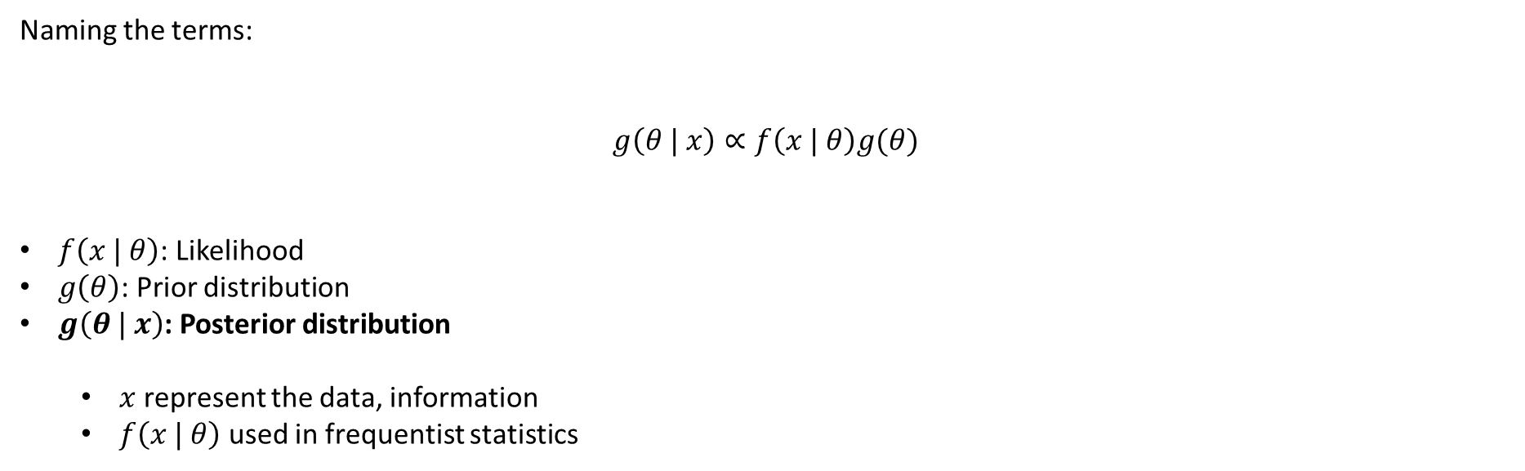
Bayesian inference
Naming the terms:
$$g\left(θ | x\right)∝f\left(x | θ\right)g(θ)$$
$f\left(x | θ\right)$: Likelihood
$g\left(θ\right)$: Prior distribution
$g\left(θ | x\right)$: Posterior distribution
  $x$ represent the data, information
  $f\left(x | θ\right)$ used in frequentist statistics

Slide 35

Bayesian inference
Naming the terms:
$$g\left(θ | x\right)∝f\left(x | θ\right)g(θ)$$
$f\left(x | θ\right)$: Likelihood
$g\left(θ\right)$: Prior distribution
$g\left(θ | x\right)$: Posterior distribution
  $x$ represent the data, information
  $f\left(x | θ\right)$ used in frequentist statistics

Slide 36
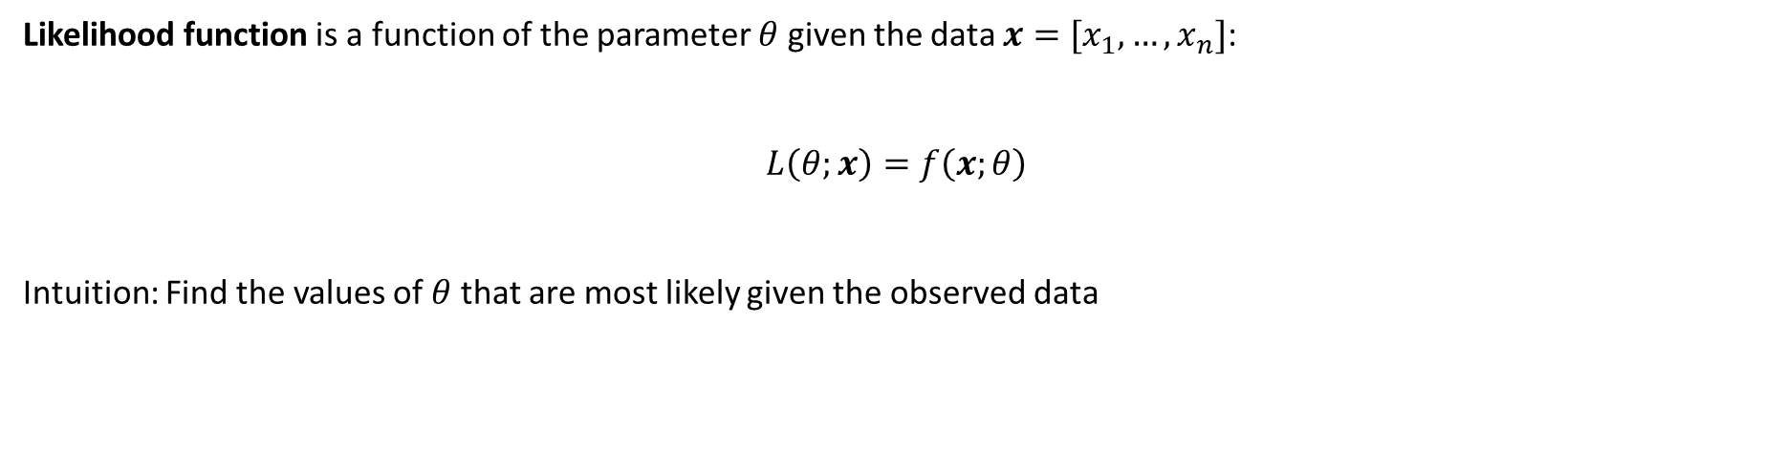
Likelihood
Likelihood function is a function of the parameter $θ$ given the data $x=[x_{1}, …, x_{n}]$:
$$L\left(θ;x\right)=f\left(x;θ\right)$$
Intuition: Find the values of $θ$ that are most likely given the observed data

Slide 37
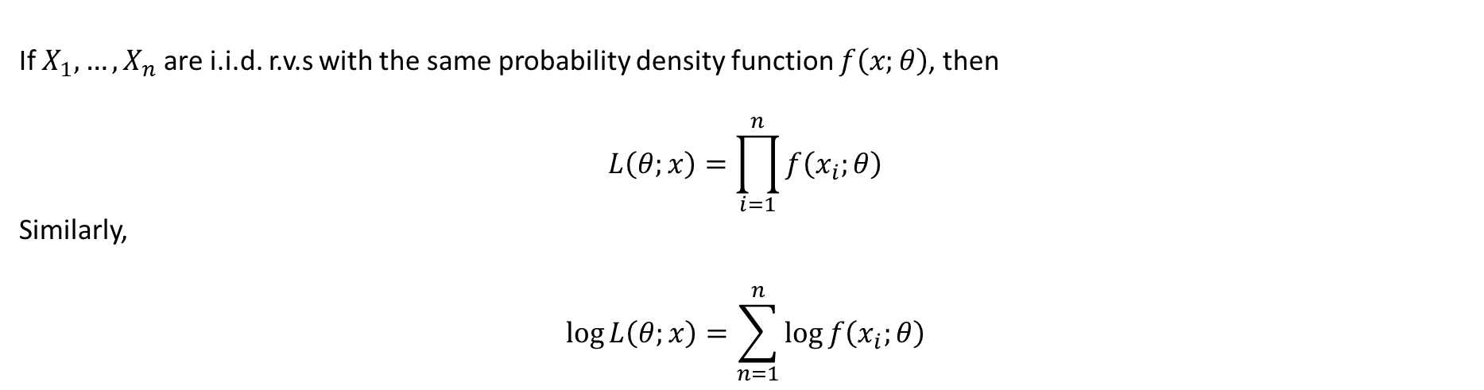
Likelihood
If $X_{1},…, X_{n}$ are i.i.d. r.v.s with the same probability density function $f\left(x;θ\right)$, then
$$L\left(θ;x\right)=\prod_{i=1}^{n}{f\left(x_{i};θ\right)}$$
Similarly,
$$\log{L\left(θ;x\right)}=\sum_{n=1}^{n}{\log{f\left(x_{i};θ\right)}}$$

Slide 38
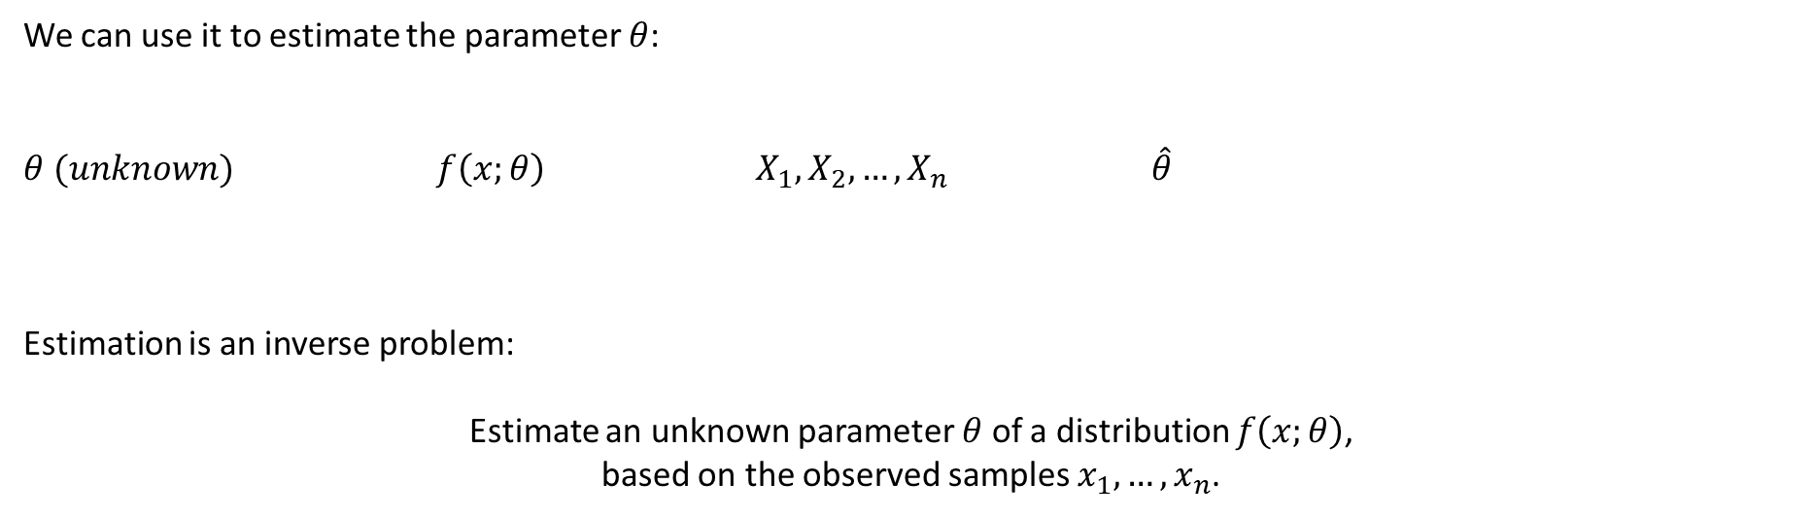
Likelihood
We can use it to estimate the parameter $θ$:
$$θ (unknown) f\left(x;θ\right) { X}_{1}, X_{2},…, X_{n} \hat{θ}$$
Estimation is an inverse problem:
Estimate an unknown parameter $θ$ of a distribution $f\left(x;θ\right)$,
based on the observed samples $x_{1},…, x_{n}$.

Slide 39
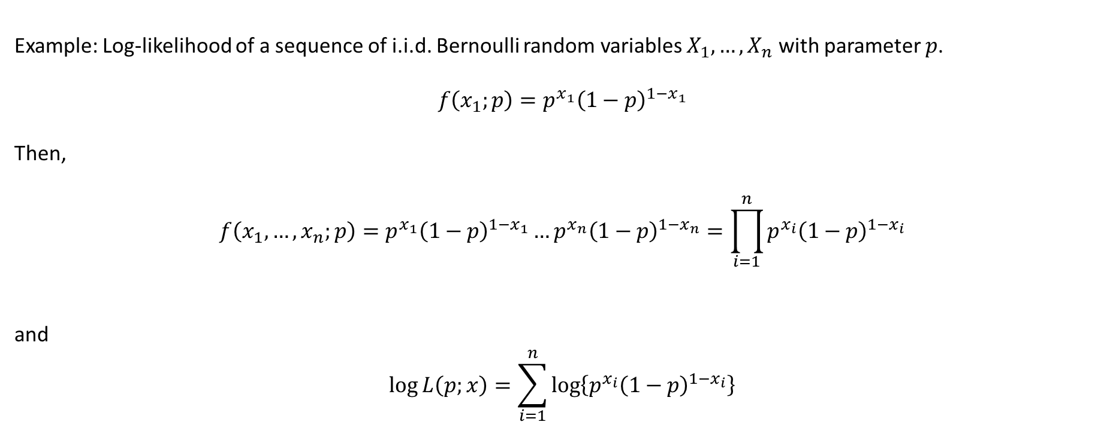
Likelihood
Example: Log-likelihood of a sequence of i.i.d. Bernoulli random variables $X_{1},…, X_{n}$ with parameter $p$.
$$f\left(x_{1};p\right)=p^{x_{1}}{\left(1−p\right)}^{{1−x}_{1}}$$
Then,
$$f\left(x_{1},…, x_{n};p\right)=p^{x_{1}}{\left(1−p\right)}^{{1−x}_{1}}…p^{x_{n}}{\left(1−p\right)}^{{1−x}_{n}}=\prod_{i=1}^{n}{p^{x_{i}}{\left(1−p\right)}^{{1−x}_{i}}}$$
and
$$\log{L\left(p;x\right)}=\sum_{i=1}^{n}{\log\left\{p^{x_{i}}{\left(1−p\right)}^{{1−x}_{i}}\right\}}$$

Slide 40
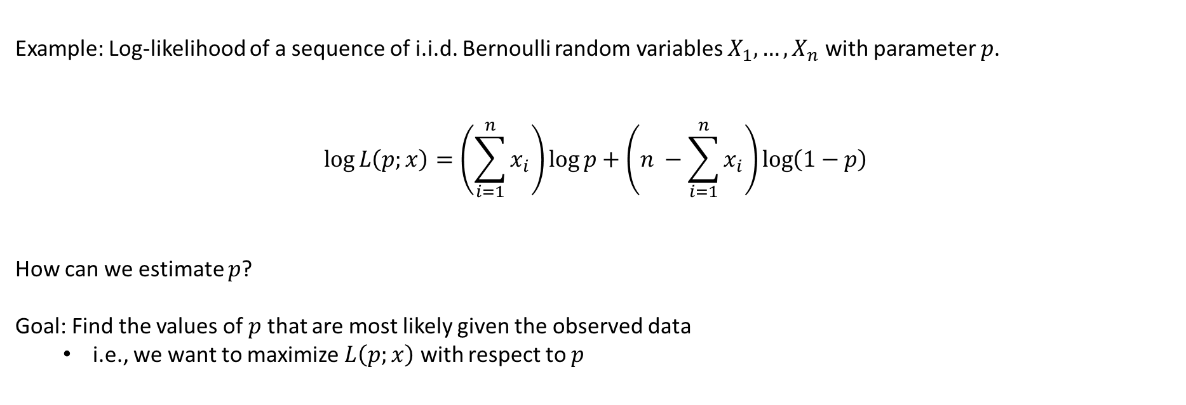
Likelihood
Example: Log-likelihood of a sequence of i.i.d. Bernoulli random variables $X_{1},…, X_{n}$ with parameter $p$.
$$\log{L\left(p;x\right)}=\left(\sum_{i=1}^{n}{x_{i}}\right)\log{p}+\left(n −\sum_{i=1}^{n}{x_{i}}\right)\log\left(1−p\right)$$
How can we estimate $p$?
Goal: Find the values of $p$ that are most likely given the observed data
  i.e., we want to maximize $L\left(p;x\right)$ with respect to $p$

Slide 41
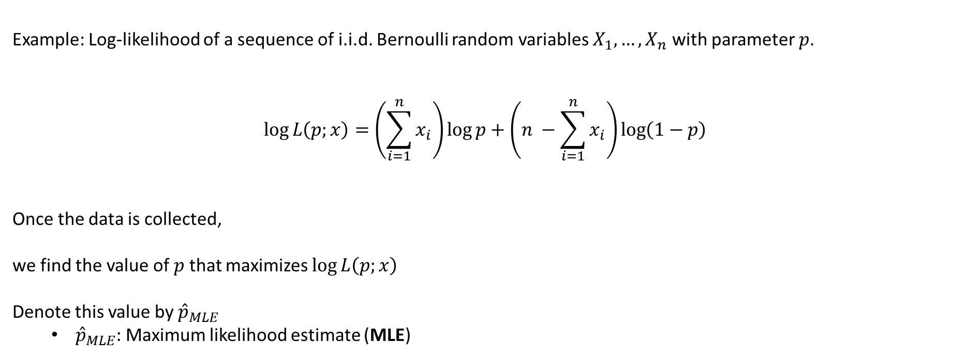
Likelihood
Example: Log-likelihood of a sequence of i.i.d. Bernoulli random variables $X_{1},…, X_{n}$ with parameter $p$.
$$\log{L\left(p;x\right)}=\left(\sum_{i=1}^{n}{x_{i}}\right)\log{p}+\left(n −\sum_{i=1}^{n}{x_{i}}\right)\log\left(1−p\right)$$
Once the data is collected,
we find the value of $p$ that maximizes $\log{L\left(p;x\right)}$
Denote this value by ${\hat{p}}_{MLE}$
  ${\hat{p}}_{MLE}:$ Maximum likelihood estimate (MLE)

Slide 42
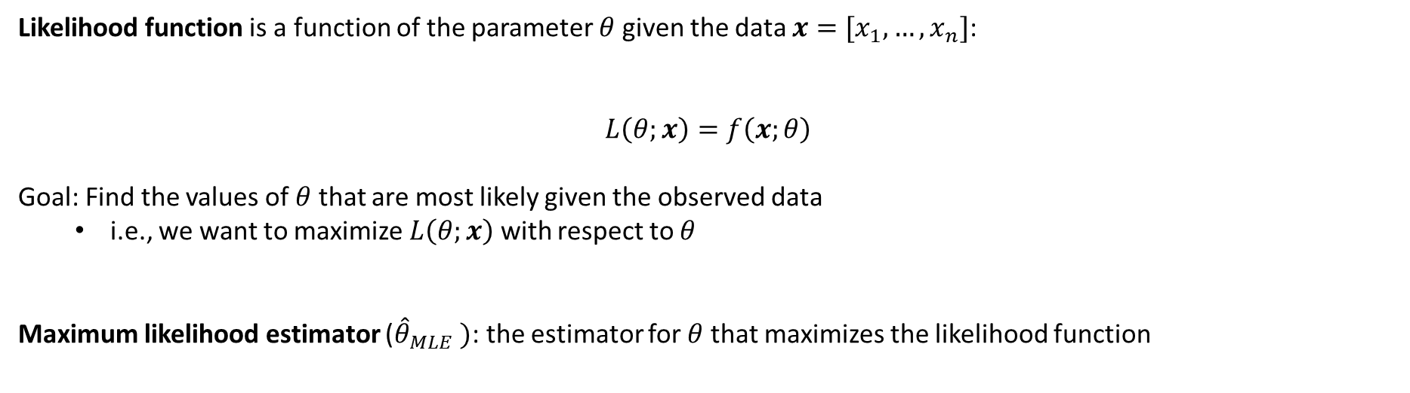
Likelihood
Likelihood function is a function of the parameter $θ$ given the data $x=[x_{1}, …, x_{n}]$:
$$L\left(θ;x\right)=f\left(x;θ\right)$$
Goal: Find the values of $θ$ that are most likely given the observed data
  i.e., we want to maximize $L\left(θ;x\right)$ with respect to $θ$
Maximum likelihood estimator (${\hat{θ}}_{MLE} )$: the estimator for $θ$ that maximizes the likelihood function

Slide 43
Likelihood
Once we have a MLE estimator, we can do the same things we have done before
Compute expected values
  bias
  variance
  check for consistency
Compute confidence intervals
Hypothesis testing

Slide 44
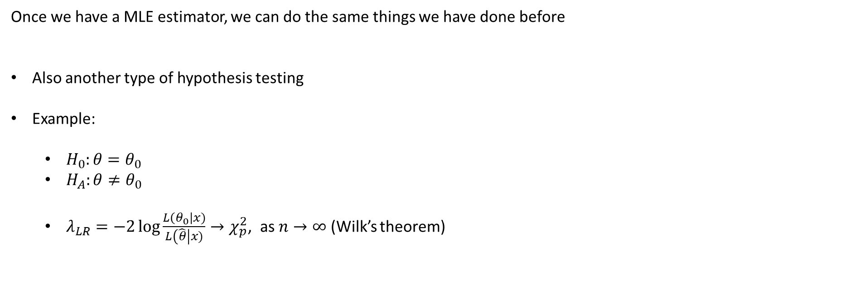
Likelihood
Once we have a MLE estimator, we can do the same things we have done before
Also another type of hypothesis testing
Example:
  $H_{0}:θ=θ_{0}$
  $H_{A}:θ≠θ_{0}$
  $λ_{LR}=−2\log{\frac{L\left(θ_{0}\right|x)}{L\left(\hat{θ}\right|x)}}→χ_{p}^{2}$, as $n→∞$ (Wilk’s theorem)

Slide 45
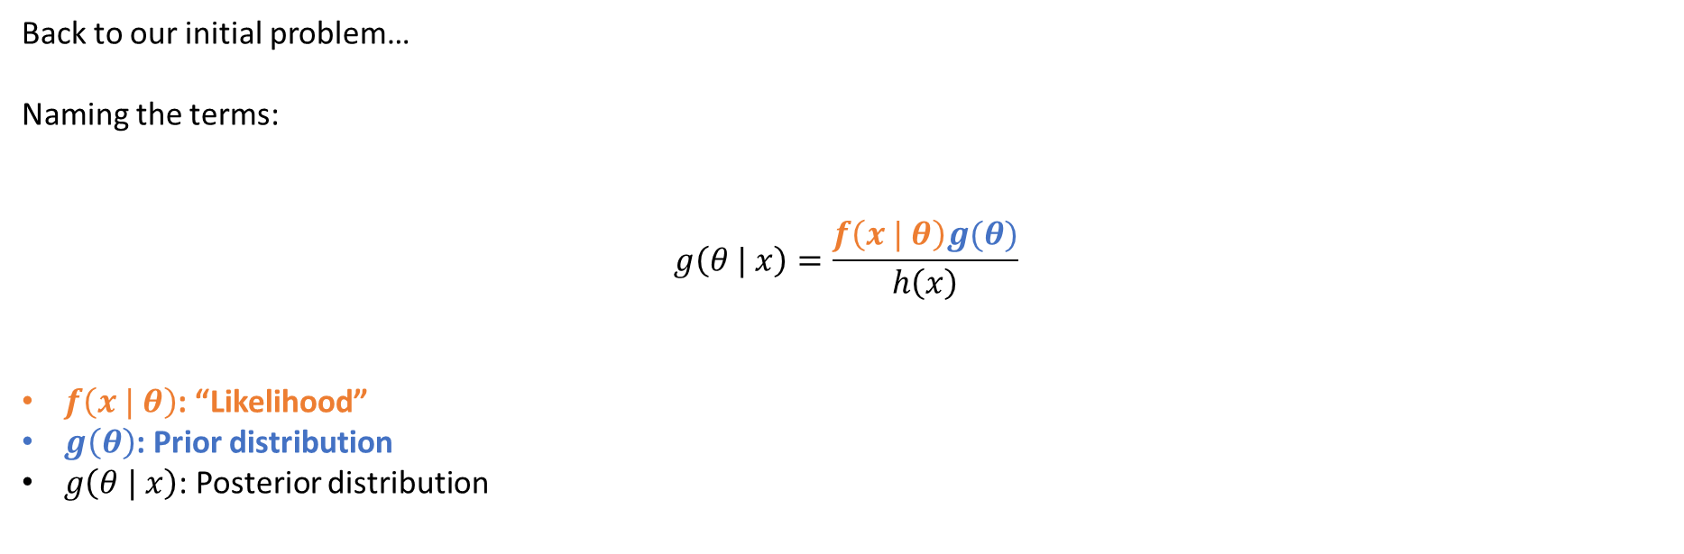
Bayesian inference
Back to our initial problem…
Naming the terms:
$$g\left(θ | x\right)=\frac{f\left(x | θ\right)g(θ)}{h\left(x\right)}$$
$f\left(x | θ\right)$: “Likelihood”
$g\left(θ\right)$: Prior distribution
$g\left(θ | x\right)$: Posterior distribution

Slide 46
Bayesian inference
Once we have the posterior $g\left(θ | x\right)$, you have everything!

Slide 47
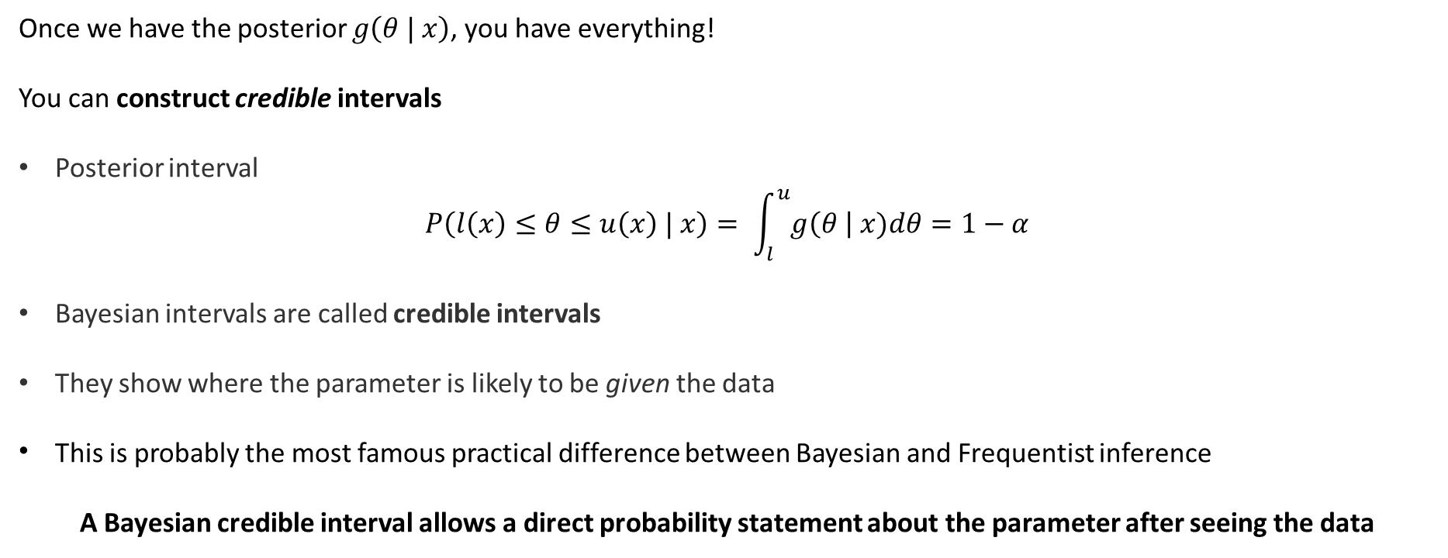
Bayesian inference
Once we have the posterior $g\left(θ | x\right)$, you have everything!
You can construct credible intervals
Posterior interval
$$P\left(l\left(x\right)≤θ≤u\left(x\right) | x\right)= \int_{l}^{u}{g\left(θ \right| x)dθ=1−α}$$
Bayesian intervals are called credible intervals
They show where the parameter is likely to be given the data
This is probably the most famous practical difference between Bayesian and Frequentist inference
A Bayesian credible interval allows a direct probability statement about the parameter after seeing the data

Slide 48
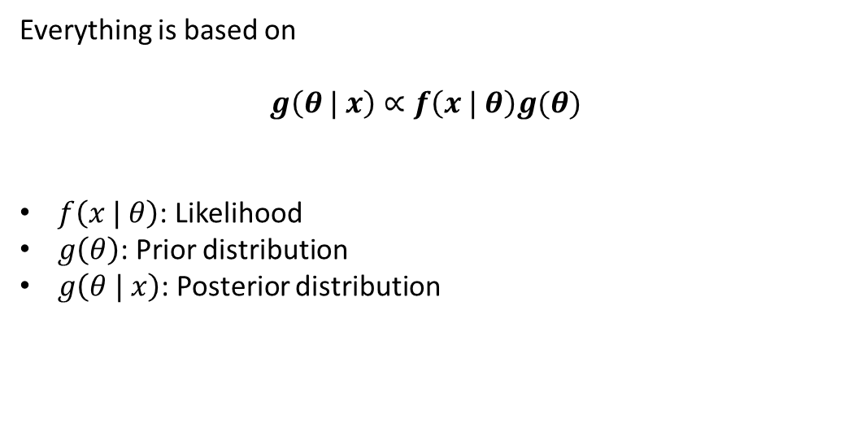
Bayesian inference
Density
Parameter
Everything is based on
$$g\left(θ | x\right)∝f\left(x | θ\right)g(θ)$$
$f\left(x | θ\right)$: Likelihood
$g\left(θ\right)$: Prior distribution
$g\left(θ | x\right)$: Posterior distribution

Slide 49
“What are some situations in which the classical approach
(or a naive implementation of it, based on cookbook recipes)
gives worse results than a Bayesian approach,
results that actually impeded the science?”
https://statmodeling.stat.columbia.edu/2013/11/13/what-are-some-situations-in-which-the-classical-approach-or-a-naive-implementation-of-it-based-on-cookbook-recipes-gives-worse-results-than-a-bayesian-approach-results-that-actually-impeded-the-s/

Slide 50
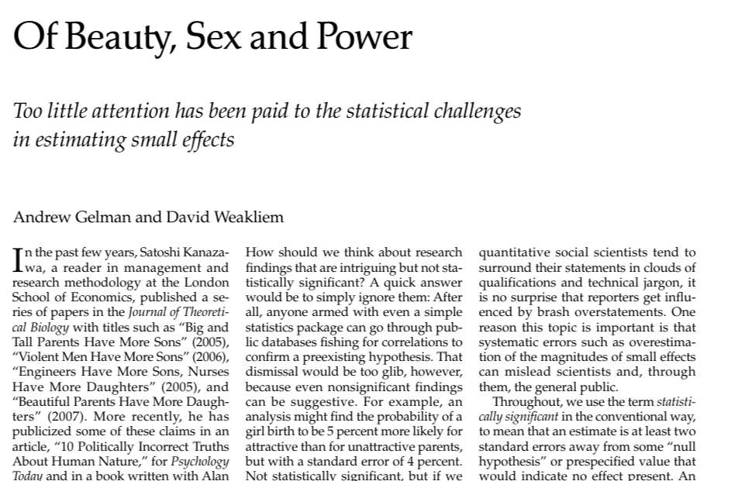
https://statmodeling.stat.columbia.edu/2013/11/13/what-are-some-situations-in-which-the-classical-approach-or-a-naive-implementation-of-it-based-on-cookbook-recipes-gives-worse-results-than-a-bayesian-approach-results-that-actually-impeded-the-s/

Slide 51
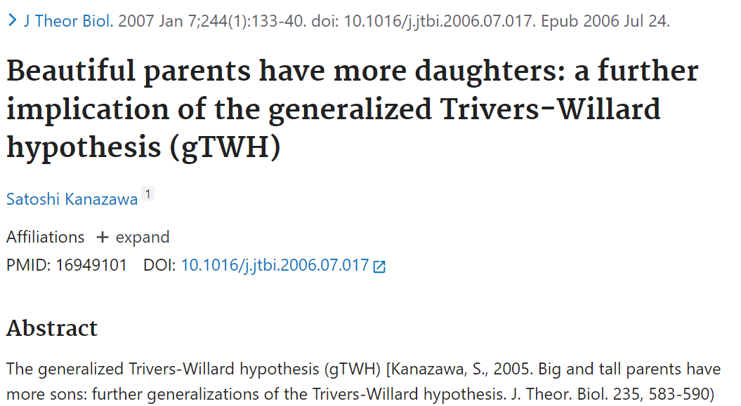
https://statmodeling.stat.columbia.edu/2013/11/13/what-are-some-situations-in-which-the-classical-approach-or-a-naive-implementation-of-it-based-on-cookbook-recipes-gives-worse-results-than-a-bayesian-approach-results-that-actually-impeded-the-s/

Slide 52


https://statmodeling.stat.columbia.edu/2013/11/13/what-are-some-situations-in-which-the-classical-approach-or-a-naive-implementation-of-it-based-on-cookbook-recipes-gives-worse-results-than-a-bayesian-approach-results-that-actually-impeded-the-s/

Slide 53
It is a study with n=3000, looking at the attractiveness of parents and the sexes of their children.
The published analysis compared the proportion of girl births among the parents who were labeled “very attractive,” compared to the proportion of girl births of the other parents.
The difference was 0.08 with a standard error of 0.03, thus statistically significant.
However, there is a lot of prior information on this topic. It would be inplausible for the true difference in the population to be as large as 0.01.
A reasonable prior distribution might have a mean of 0 and a standard deviation of 0.003. Under such a prior, the Bayesian inference is that the population difference is very close to 0.
To be precise, the posterior mean is 0.0008 (that is, less than 1/10 of one percentage point, for example Pr(girl) changing from 0.488 to 0.489) with a posterior standard deviation of 0.003.
Thus, in the Bayesian analysis, the result is not anything close to statistically significant.
https://statmodeling.stat.columbia.edu/2013/11/13/what-are-some-situations-in-which-the-classical-approach-or-a-naive-implementation-of-it-based-on-cookbook-recipes-gives-worse-results-than-a-bayesian-approach-results-that-actually-impeded-the-s/

Slide 54
This not about: “Bayesian methods are better!”
classical analyses may overreact to noisy data
  small effect sizes,
  noisy estimates,
  statistical significance being confused with scientific significance
while Bayesian modeling
  partially pools information and
  focus on magnitude rather than significance
  often encourage us to focus on scientific relevance, uncertainty, and effect sizes instead of simply relying on statistical significance.
This is an anecdotal example of bad statistics – just for fun!
https://statmodeling.stat.columbia.edu/2013/11/13/what-are-some-situations-in-which-the-classical-approach-or-a-naive-implementation-of-it-based-on-cookbook-recipes-gives-worse-results-than-a-bayesian-approach-results-that-actually-impeded-the-s/

Slide 55
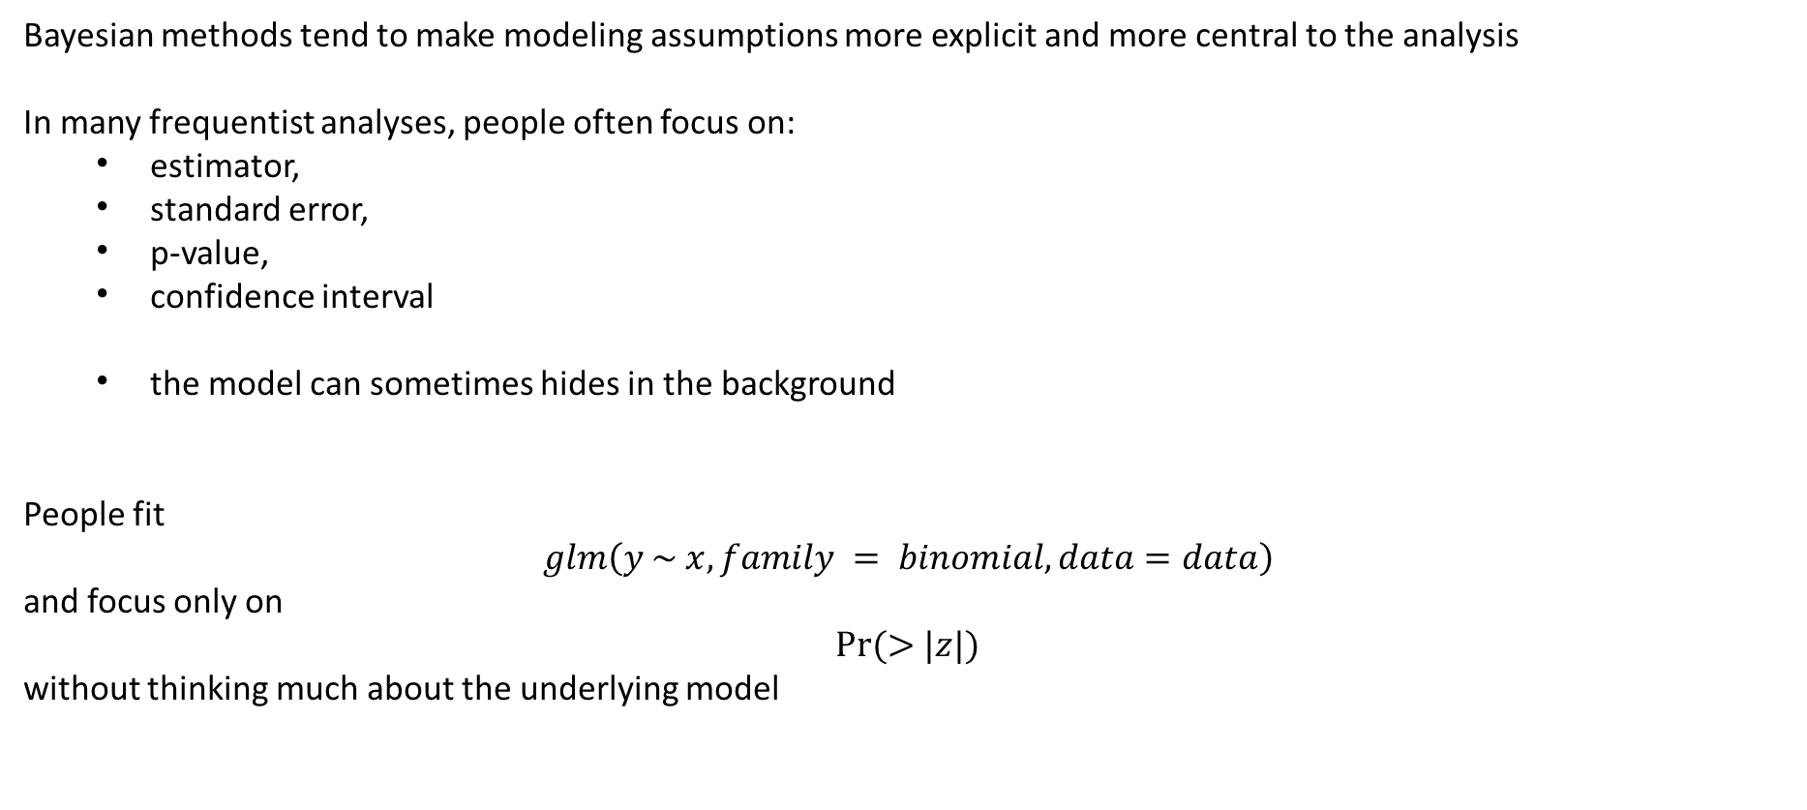
Bayesian methods tend to make modeling assumptions more explicit and more central to the analysis
In many frequentist analyses, people often focus on:
  estimator,
  standard error,
  p-value,
  confidence interval
  the model can sometimes hides in the background
People fit
$$glm\left(y \sim x, family = binomial, data=data\right)$$
and focus only on
$$Pr⁡(>|z|)$$
without thinking much about the underlying model

Slide 56

In Bayesian statistics, everything is based on
$$g\left(θ | x\right)∝f\left(x | θ\right)g(θ)$$
you are forced to specify
  Likelihood model
  Prior model
The model is clear and center in the approach

Slide 57

Next steps
Density
Parameter
Everything is based on
$$g\left(θ | x\right)∝f\left(x | θ\right)g(θ)$$
$f\left(x | θ\right)$: Likelihood
$g\left(θ\right)$: Prior distribution
  How to select prior distributions?
$g\left(θ | x\right)$: ??

Slide 58
THANK YOU!

